Slide 1

Zowe 3Q 2023 PI Planning
TSC Focus
Presenters: Jakub Balhar

Slide 2

Mission
Simplify the usage of the zOS
Reduce the learning curve for zOS
Attract new people to zOS
Build great community
Meaning of life

Slide 3
Themes

Slide 4

Installation and Configuration Experience
Work continues.
Delivered
Improved documentation on certificates
Certain improvements in logging
Server Side
Certificate management
Improved logging
Better automation
Fighting the installation

Slide 5

Security - continues from previous PI
Open SSF recommendations
Supply Chain Security improvements
Waiting Danger

Slide 6

Feedback
Deeper integration with the users
Publish better information on the System Demos
Invite the users to the PI Planning
Improve usage of zowe mailing lists
Better present the results of question of the month
Not enough feedback

Slide 7
Policies

Slide 8

Assets - continued
What types we have?
How do we want to store them?
How do we collaborate?
Our assets

Slide 9

Testing - continued
Unit testing
Functional Testing
Acceptance Testing
Penetration Testing
Codify Best Practices
Careful, you get burned otherwise

Slide 10
Plans

Slide 11

Version 3
Updates to the Conformance program
Preview release for extenders
Office hours for extenders and users.
Third book in series

Slide 12

Education and certification
Cooperation with Interskill
|Let’s learn

Slide 13

Security
Continue with the Core Infrastructure Initiative requests
I will secure your code!

Slide 14
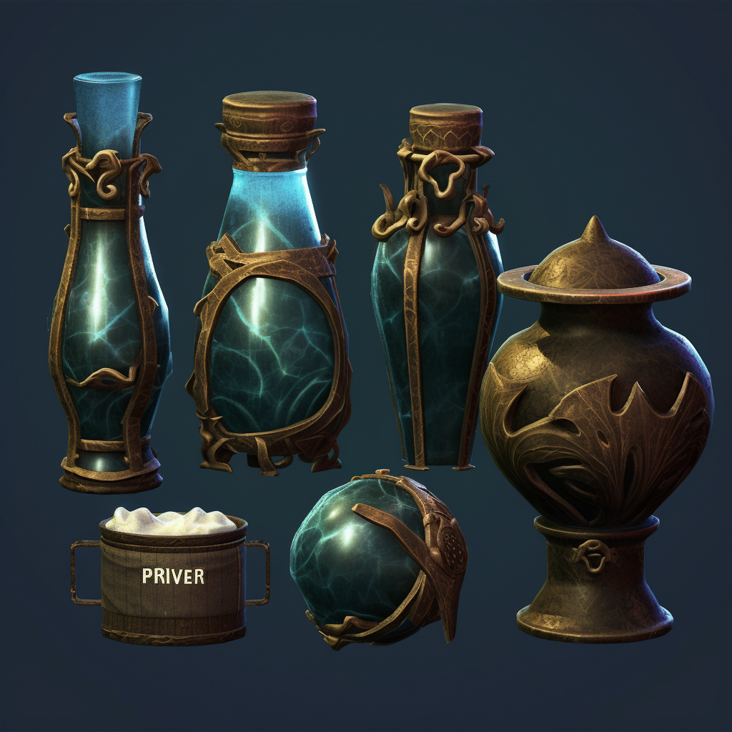
Technical Testing
When do we claim support for specific Node, Java, zOS?
We need to codify the information and make sure they are visible.
It won’t work without these

Slide 15
State of the community

Slide 16
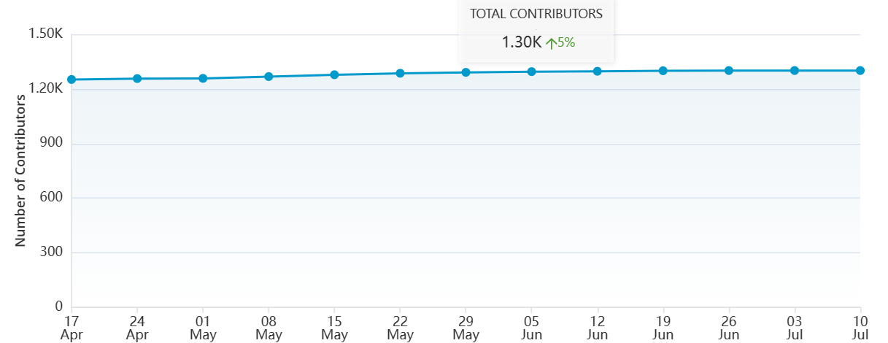
Contributors

Slide 17
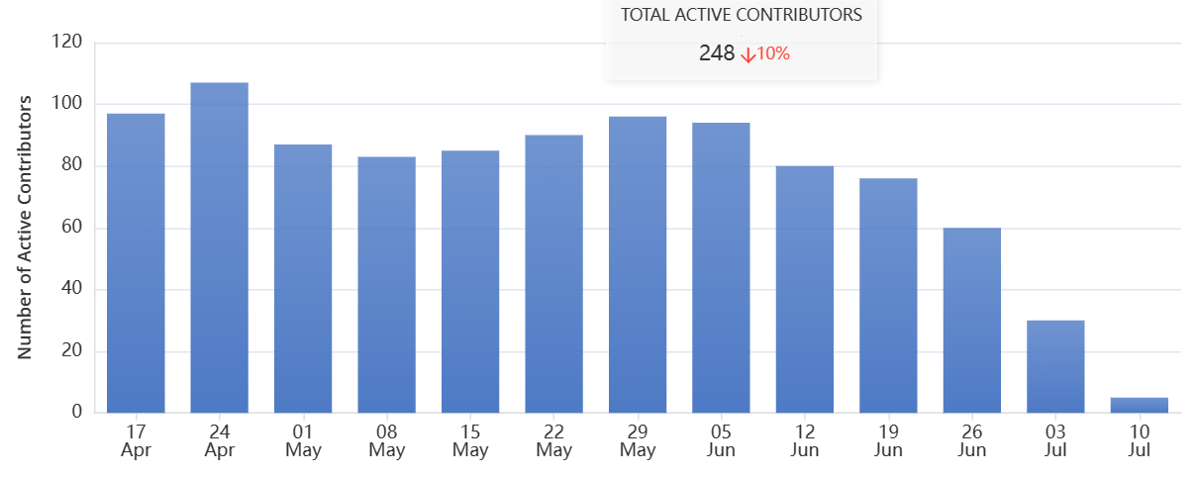
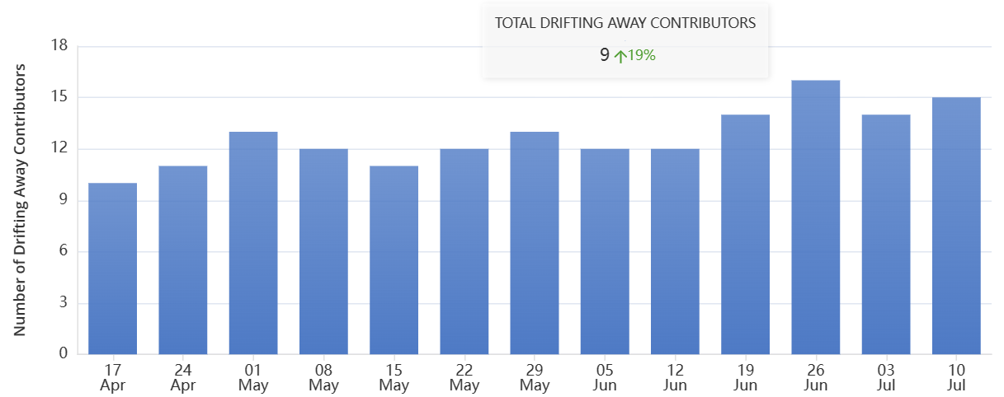
Contributors Change

Slide 18
State of the code

Slide 19
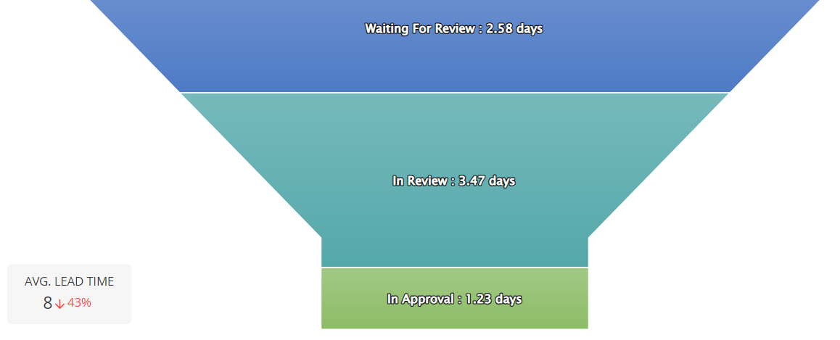
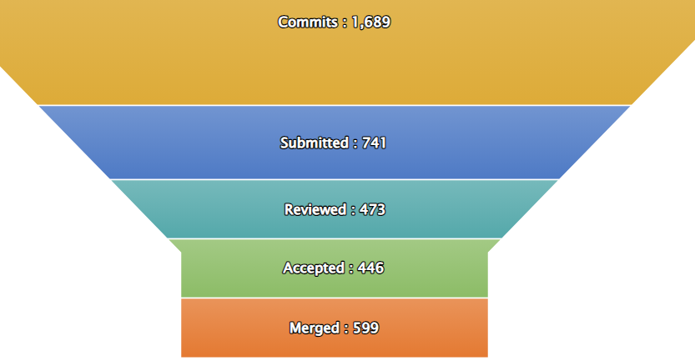
Code Pipeline
Notes:
No meaningful change compared to previous PI.

Slide 20
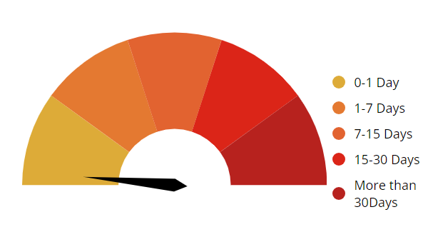
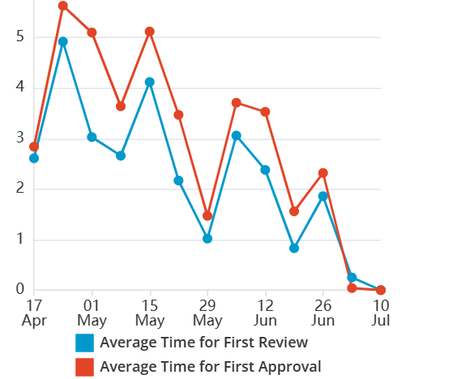
Merge / Review
Notes:
Improvements compared to previous PI - By around half day on the merge.
Improved by aaprox. 30% on time to first review and approval.

Slide 21
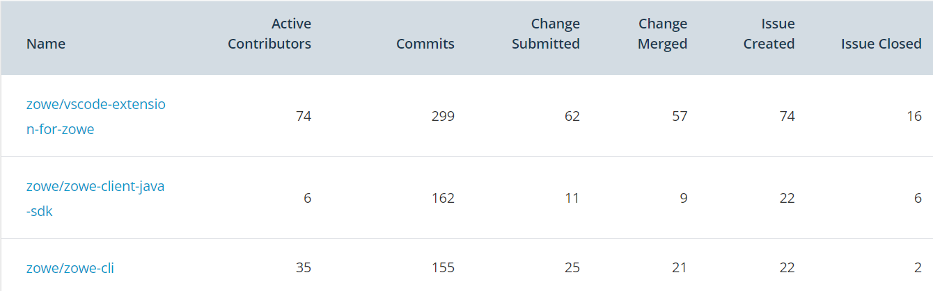
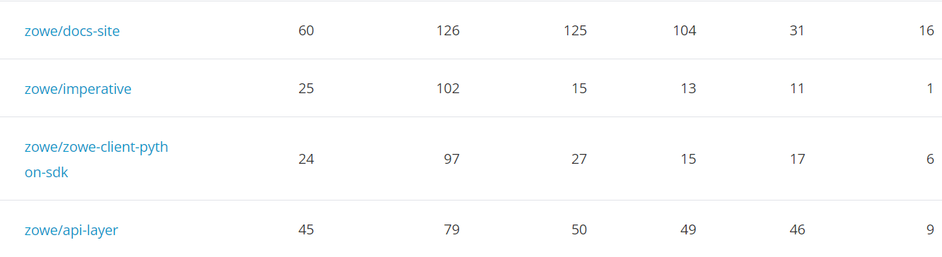
Repository Slides

